Slide 1
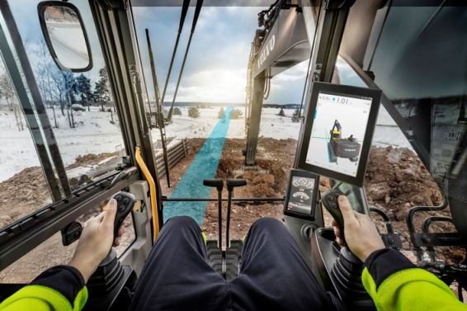
Co Pilot driver statistics project
11/18/2016
Team members:
Vladimir Djukanovic
Leslie Dahlberg
Léa Brunschwig
Eric Engtorp
Fredrik Frenning
Pooria Ghavamian
Hamza Sabljakovic

Slide 2
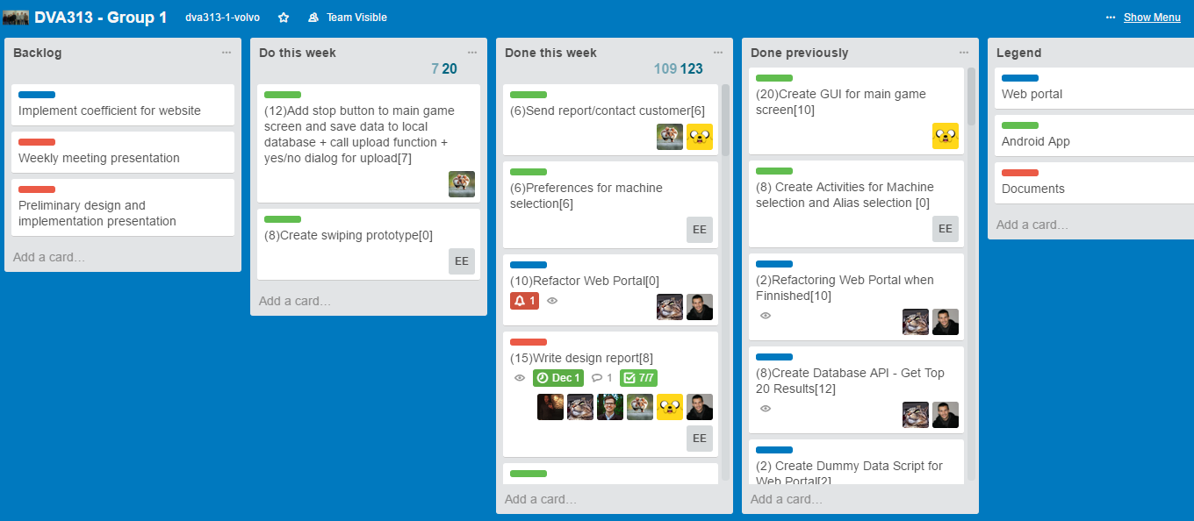
Trello – last week

Slide 3
Last week - establishments
Design description document – initial
Contact with Volvo – established next meeting
Implementation:
Web application
Switch between graphs (fuel, speed etc...)
Create API for uploading data to Web Portal
Choose the vehicle and get the high score list for selected vehicle - Web portal
Fix bug: After changing machine, buttons for selecting different data (FUEL, load, etc.) stop working
Fixed left sidebar
Improve queries to avoid SQL injection (prepared statements)
Loader: on machine change
Android application
Read CPAC data in CanBusInformation class
Implement coefficients for app and normalized data to values between 0 and 1
Implement button navigation
Write function for network connection and upload to website
Research and test instant notification based on score
Implement average in live feed
Create mock CAN bus interface
Feed main game screen with live data feed
Clean up graphing function in game screen
Light retouch of GUI for App
Get Average of sqlite data from db
Test App on Co-Pilot

Slide 4
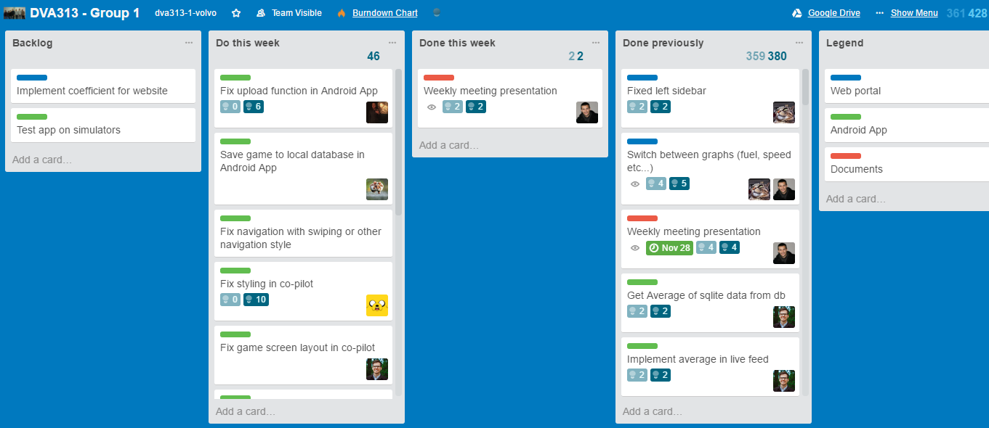
Trello – following week

Slide 5
Plan for following week
Weekly meeting presentation
Design description presentation
Web Portal implementation:
Fix update handler
Android application implementation:
Fix upload function in Android App
Save game to local database in Android App
Fix navigation with swiping or other navigation style
Fix styling in co-pilot
Fix game screen layout in co-pilot
Replace bitmap graphics with vector SVG graphics
Test can buss reader
Fix toast notification
Change excavator to alias (alias placeholder)

Slide 6
Obstacles
Co Pilot responsiveness - PASSED
Different GUI in compare with standard Android – NOT PASSED

Slide 7
Worked hours
Name | Last week | Total
Vladimir Djukanovic | 21 | 78
Hamza Sabljakovic | 21.5 | 78.5
Léa Brunschwig | 20 | 50
Eric Engtorp | 18 | 73
Fredrik Frenning | 19 | 74
Pooria Ghavamian | 20 | 75
Leslie Dahlberg | 22 | 77

